Slide 1
What/who makes a successful toy product?
Elizabeth Earl
DSC 680 – T301
Second project – week 8

Slide 2
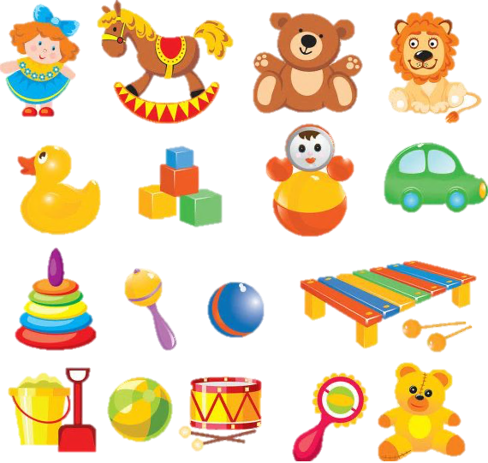
TOYS, TOYS, TOYS!
Toys are everywhere making the market for them competitive
Toys come in all shapes and sizes, so what makes or breaks a toy?
It is hard for old school toy types to compete in a technologically driven new world

Slide 3
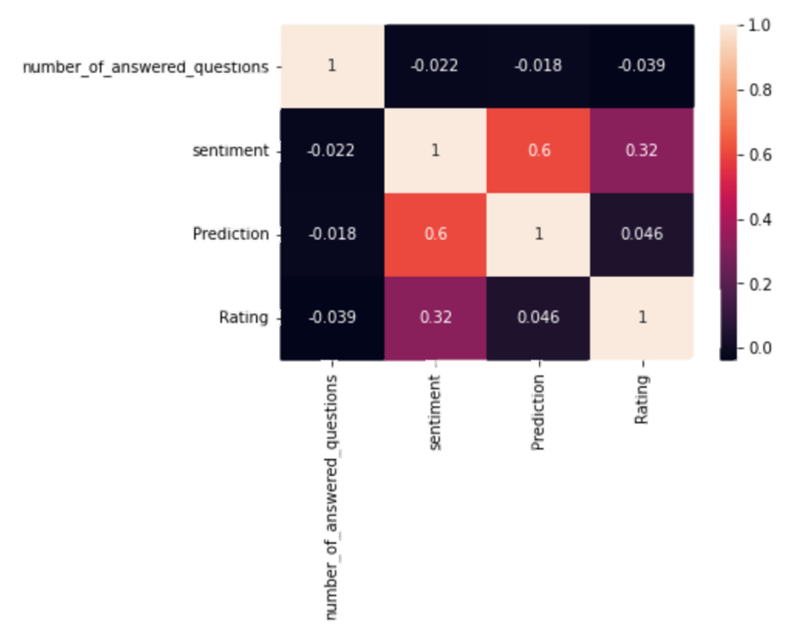
Impacting variables
number_of_answered_questions
sentiment
prediction
rating

Slide 4
What influences a purchase?
‘plush’
‘soft’
‘squish’
‘youtube’
‘video’
'collectible'
Key words in reviews (after a verified purchase)

Slide 5
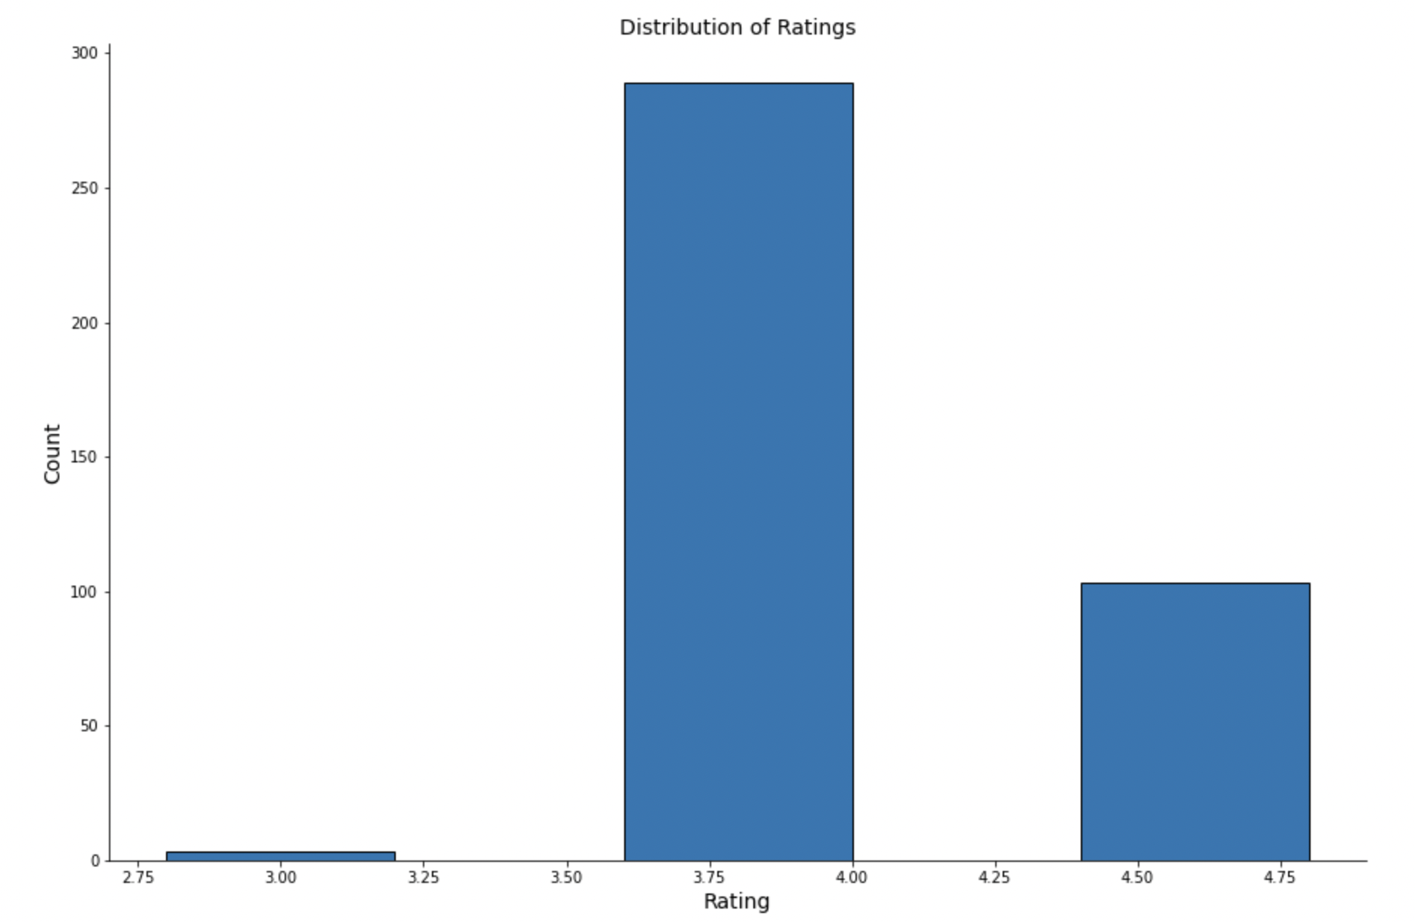
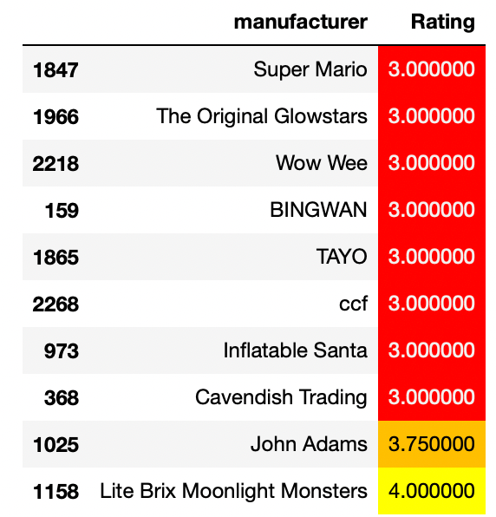
Third-party Impact
Ex. Wow Wee vs WowWee

Slide 6
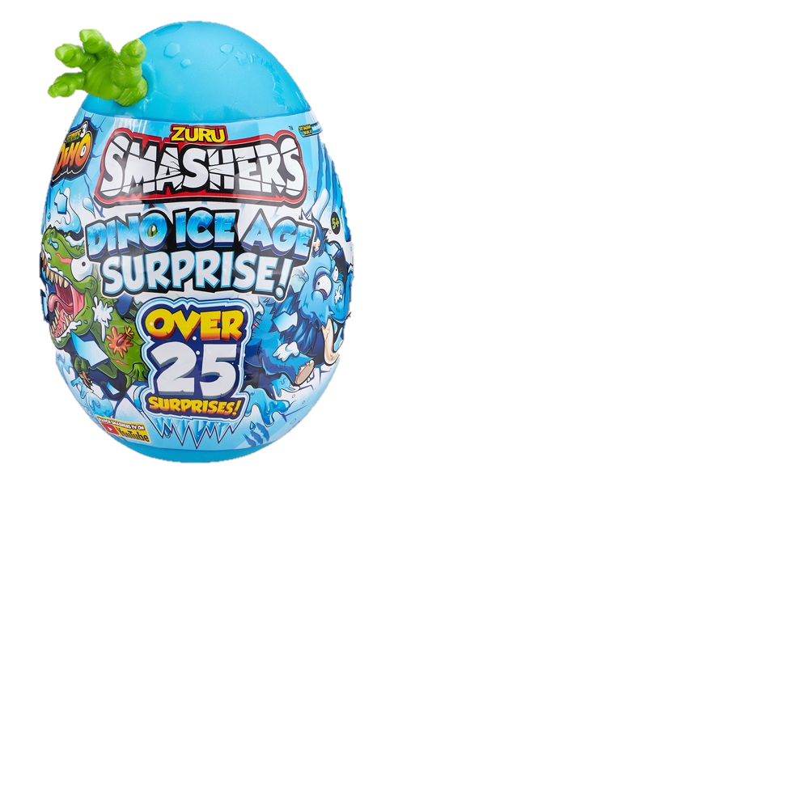
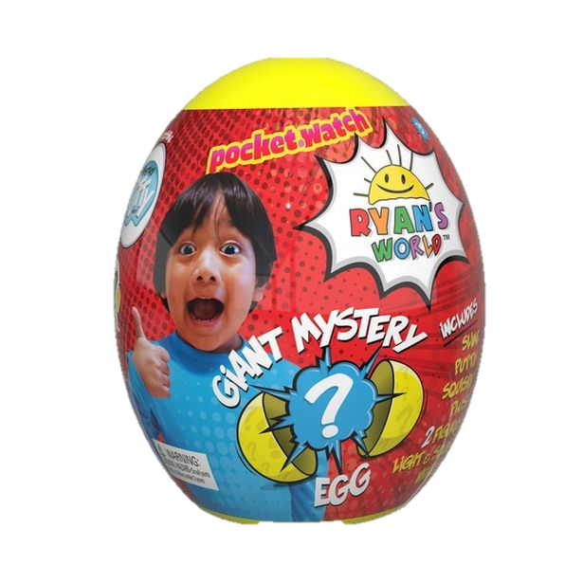
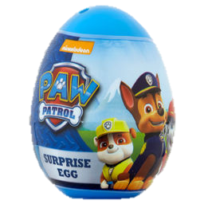
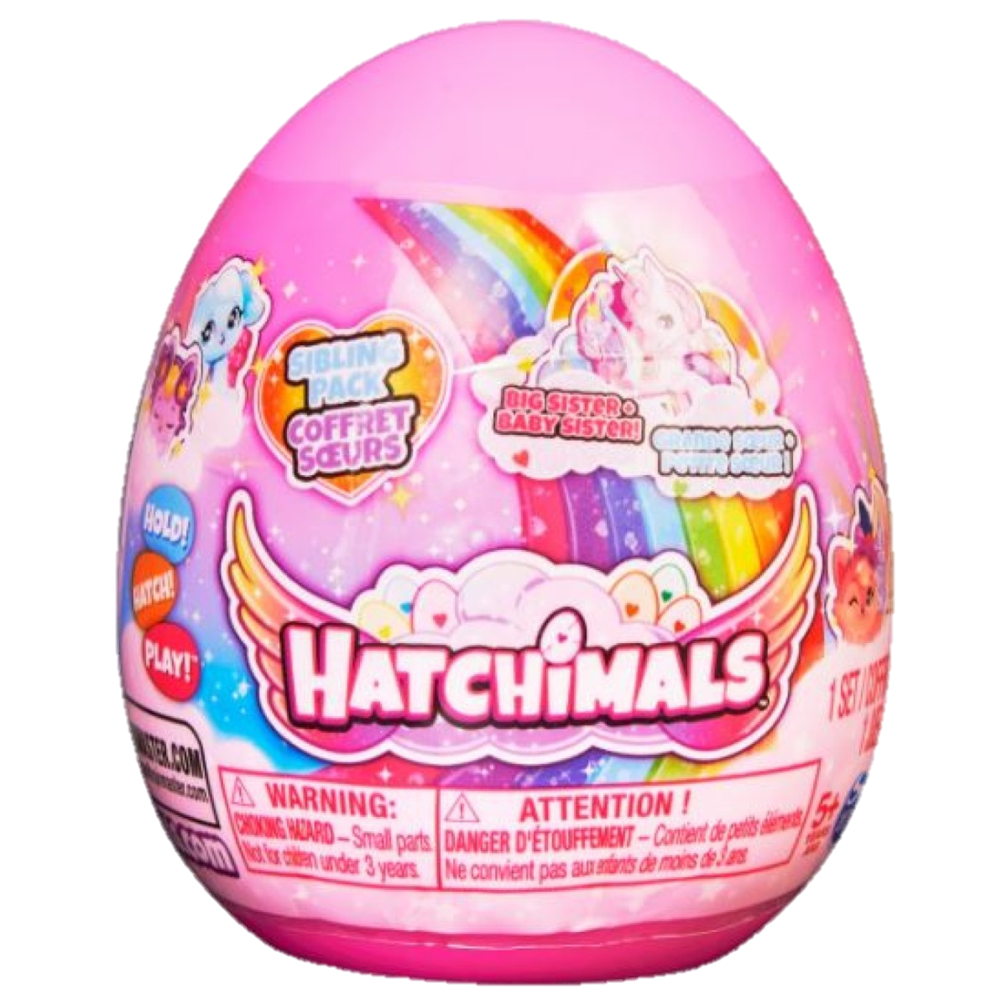
Value vs Hype
Social media = influencers
YouTube influencer branded toys have taken over the market
What does a name on a toy mean?
Same toy (and company) different branding images
or
Better/worse toy because it is made by a different company

Slide 7
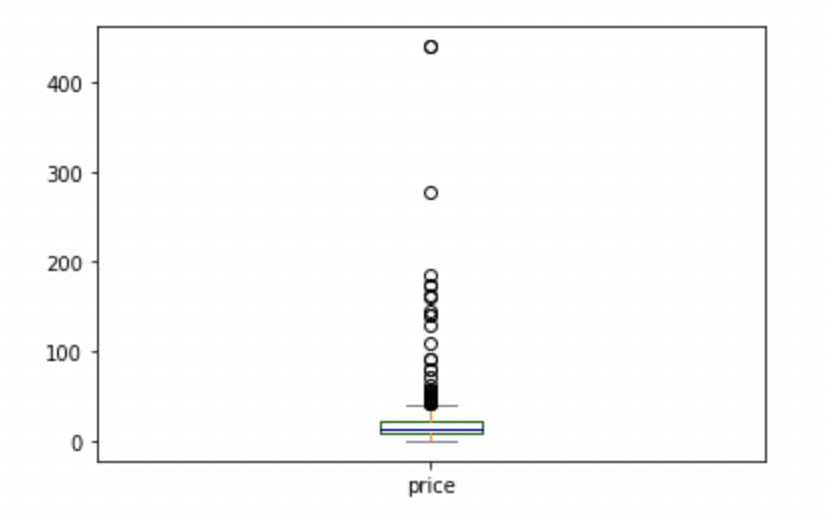
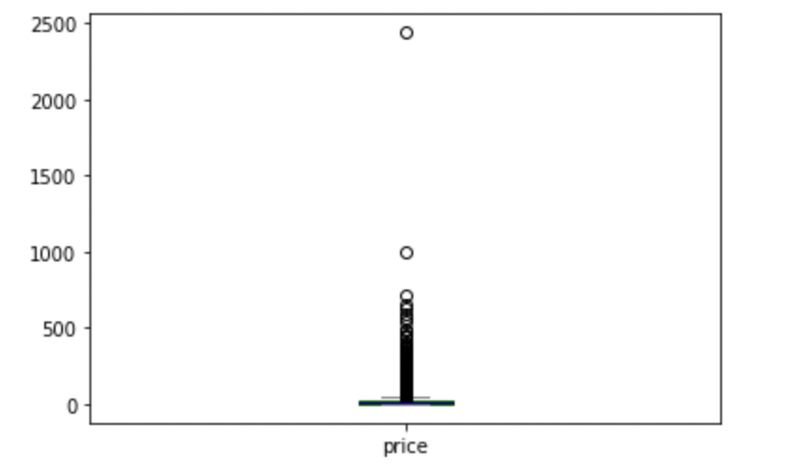
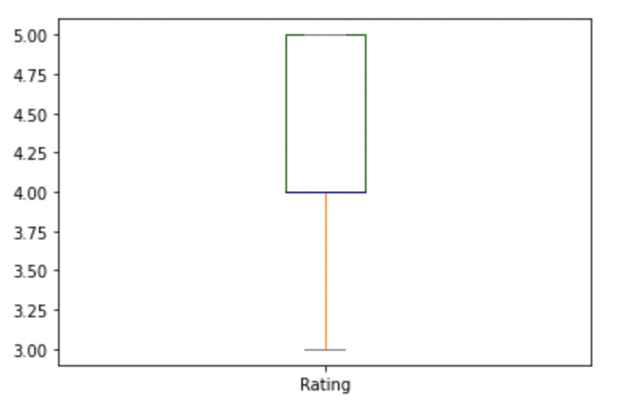
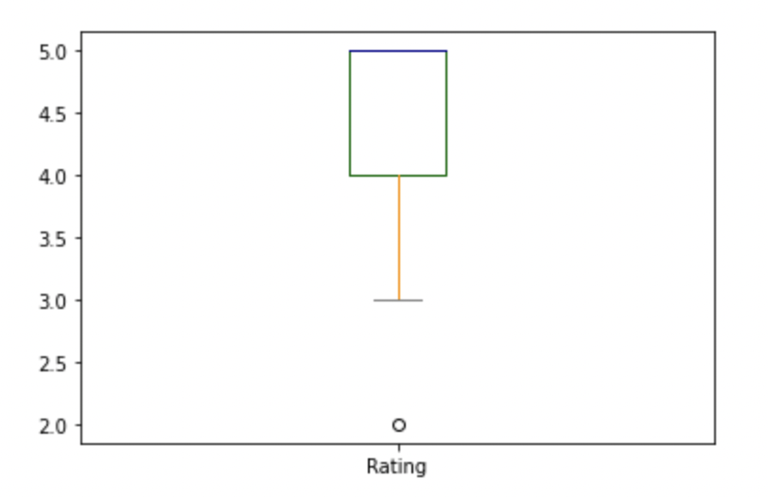
Findings
Sub Dataset:
Original Dataset:
Price: ~£23.54 ~£20.26
Rating: ~4.25 ~4.51

Slide 8
Conclusion
If your interests are the ‘popular’ option, stick with it
Avoid falling for social media tactics through influencers

